Slide 1

October 31, 2016
Nashville, TN
SOC REVEAL

Slide 2
Agenda
Introduction
Project Update
Project Goals
Our Neighborhood
SOC Reveal
What's Next
Notes:
Welcome:
Thank you to everyone for coming out to learn more about the new Support Operations Center. We’re excited to share our vision and how that vision has taken shape within our new SOC work environment.
Introduction:
Here with us today we have the Shaping Tomorrow Project Lead Sarah Jabbari. <<Intro Text>>

Slide 3
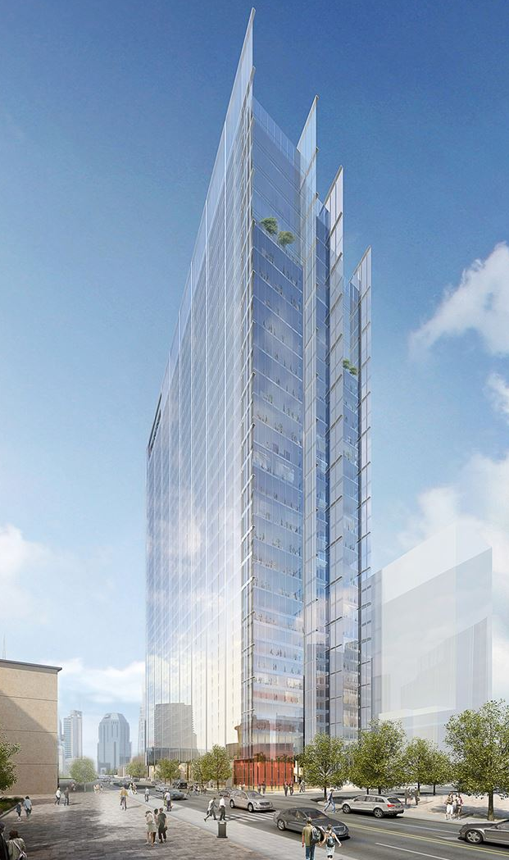
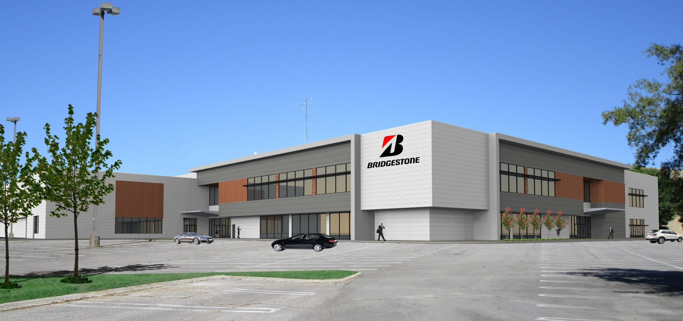
Project Update
The renderings contained in this presentation are representative images of the interior of our future Service Operations Center.
Service Operations Center (SOC)
Notes:
***Sarah Jabbari***
Thank you!
Two Locations:
In early July, the Shaping Tomorrow team shared we will have two locations in the Nashville area, our new HQ building and a satellite site in nearby Antioch, TN. Our reveal today is focused on the SOC design.
Who goes where:
Teams occupying the SOC were chosen based on their work-styles, and we’ve been working with the management team for these groups to design a space that will meet the needs of their teams. The SOC will be equivalent in quality but different function, to address the needs of the groups who occupy it.
Our Goal Today:
We’ve designed our new work environments to meet the needs and preferences of teammates, engaging employees and doing our best to understand what you need to be productive and ensure a strong, sustainable business well into the future.
This presentation is full of architectural renderings depicting amenities, common areas, meeting rooms, and individual workspace. We’re excited to share with you how our vision is taking shape, but I must stress that we are still early in the process and finishes, branding details, or other elements may eventually differ from what is shown today. We are getting there, but we don’t have every detail worked out yet. This will be one of the many information sessions we will have with you as we start to lock down more about the building and its operations.

Slide 4

How will we get there ?
Project Goals
Why are we doing this?
Foster Innovation
Enable our People
Embrace our Future
How will we achieve these goals?
Break down Silos
Invest in Services, Technology, and Infrastructure
Instill Brand Pride
Encourage Connections
Celebrate History
Enhance Collaboration
Provide Flexibility
What will the SOC be like?
Notes:
What we are ready to show, and are thrilled to share - is what working in the space will be like. How do the workstations look? An average floor? How much meeting space will we have?
From a foundation of three Vision principles, we will get increasingly concrete and walk through a the design of the space.
First, the three goals.
Foster Innovation. This is all about bringing businesses and teammates together. To break down silos, we are collocating of all of BSAM into proximate locations in Nashville. To encourage connections, we have planned increased functional space for teammates to gather and socialize. To enhance collaboration, we have nearly doubled the current provision of meeting space in the new buildings.
Enable our People. We have invested in more ergonomic and functional work settings, including Sit/Stand desks and Glass-walled enclosed spaces that increase light in the space. We have introduced several amenities designed to improve the experience at work. We have expanded on the traditional layout of offices, cubicles, and conference rooms to include phone rooms, focus rooms, meeting spaces both informal and formal, and multipurpose space equipped to support work or social purposes. To provide flexibility, we designed space specifically for working away from your desk – in private or in public, alone or together, based on your activity and preference. Work in Shaping Tomorrow means the ability and choice to work throughout the building.
Embrace our Future. To instill brand pride we have the history of Firestone and Bridgestone on full display. Our lobby experience includes physical product displays to highlight the breadth of our business. To demonstrate our global reach we have established a committed, dominant presence in Nashville and Middle Tennessee.

Slide 5
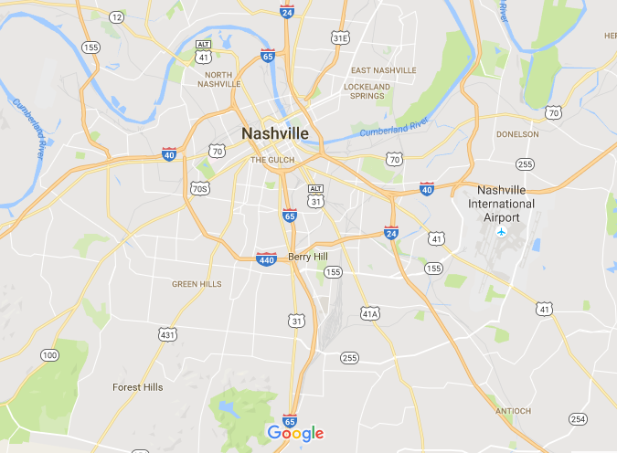
Shaping Tomorrow Locations
BSAM HQ
Service Operations Center

Slide 6
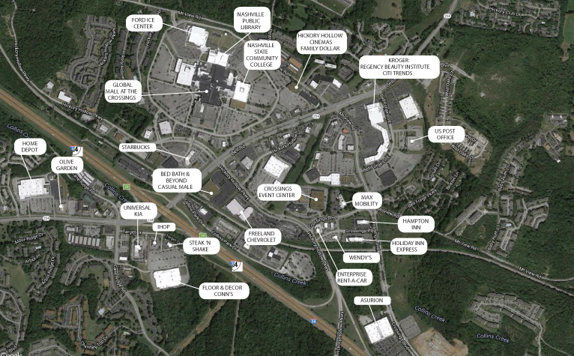
Our Neighborhood
The SOC is located near shopping, dining, and entertaining amenities, including the Nashville Predators practice facility.
Service Operations Center
Firestone Complete Auto Care

Slide 7
The Building
The SOC is a repurposed department store with adjacent surface parking, large windows, and high ceilings.
Notes:
Bridgestone was visionary to understand that a large voluminous box structure surface parking would be ideal for the future of their company and their employees. The redevelopment site included The Ford Ice Center, Metro Public Library, Nashville State Community College, and a new Community Center. The exterior would need to be modified to set itself apart from the existing attached mall. In order to achieve these requirements the entire exterior façade will be redesigned. The inclusion of new fenestration, IPEA wood and metal panels and metal canopies give the façade a new modern look.

Slide 8
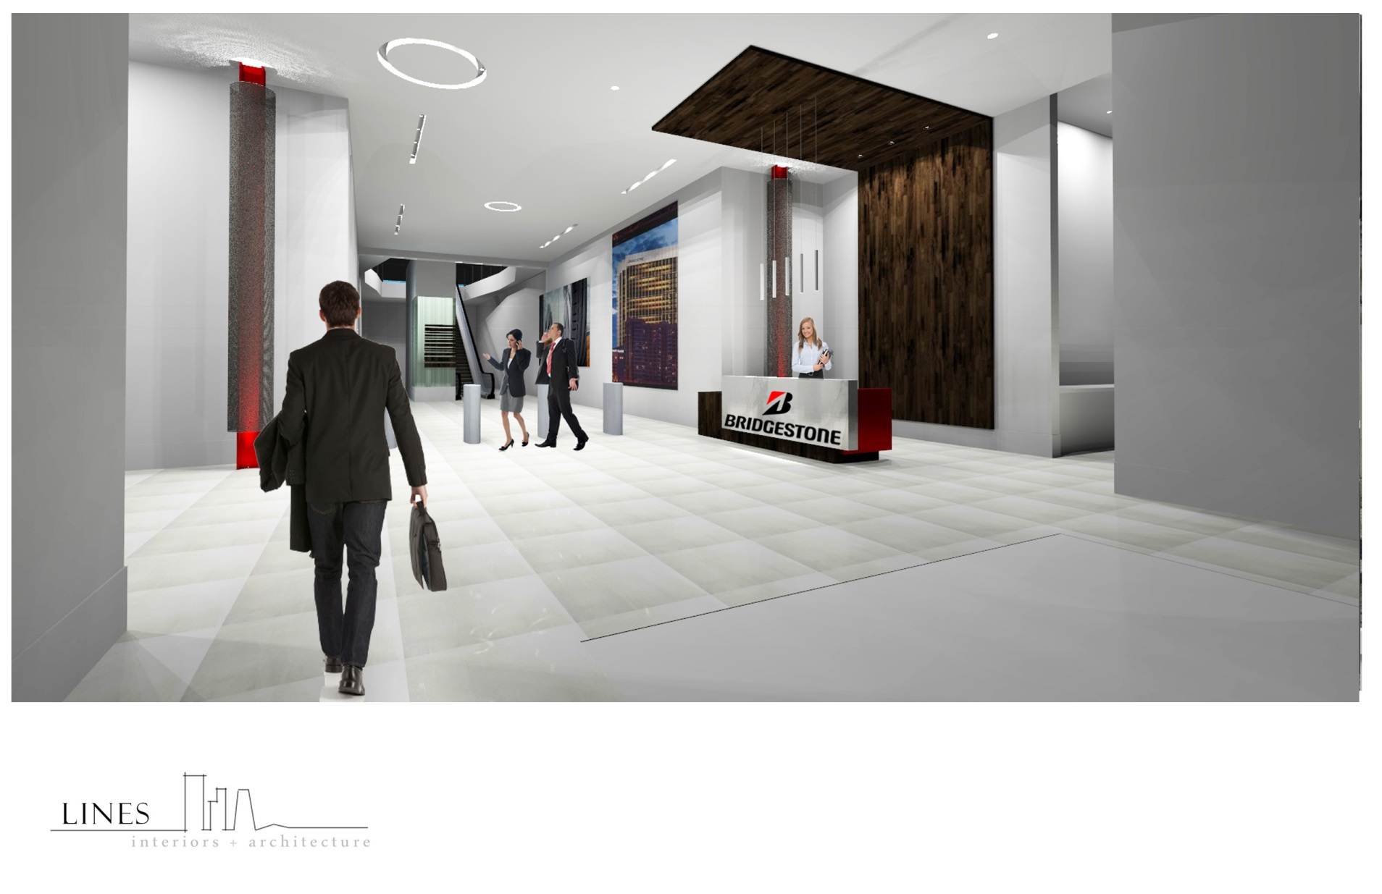
Entry
The entryway is a welcoming first impression for teammates, guests, and visitors.
Notes:
Because Bridgestone occupies the second floor design consideration was given to how and where they would approach the building. Where would be the main entry? This consideration resulted in a prominent exterior canopy leading to a first floor presence with secure lobby to an existing escalator and elevator. The escalator connects to a central spine / street scape on the second floor.

Slide 9
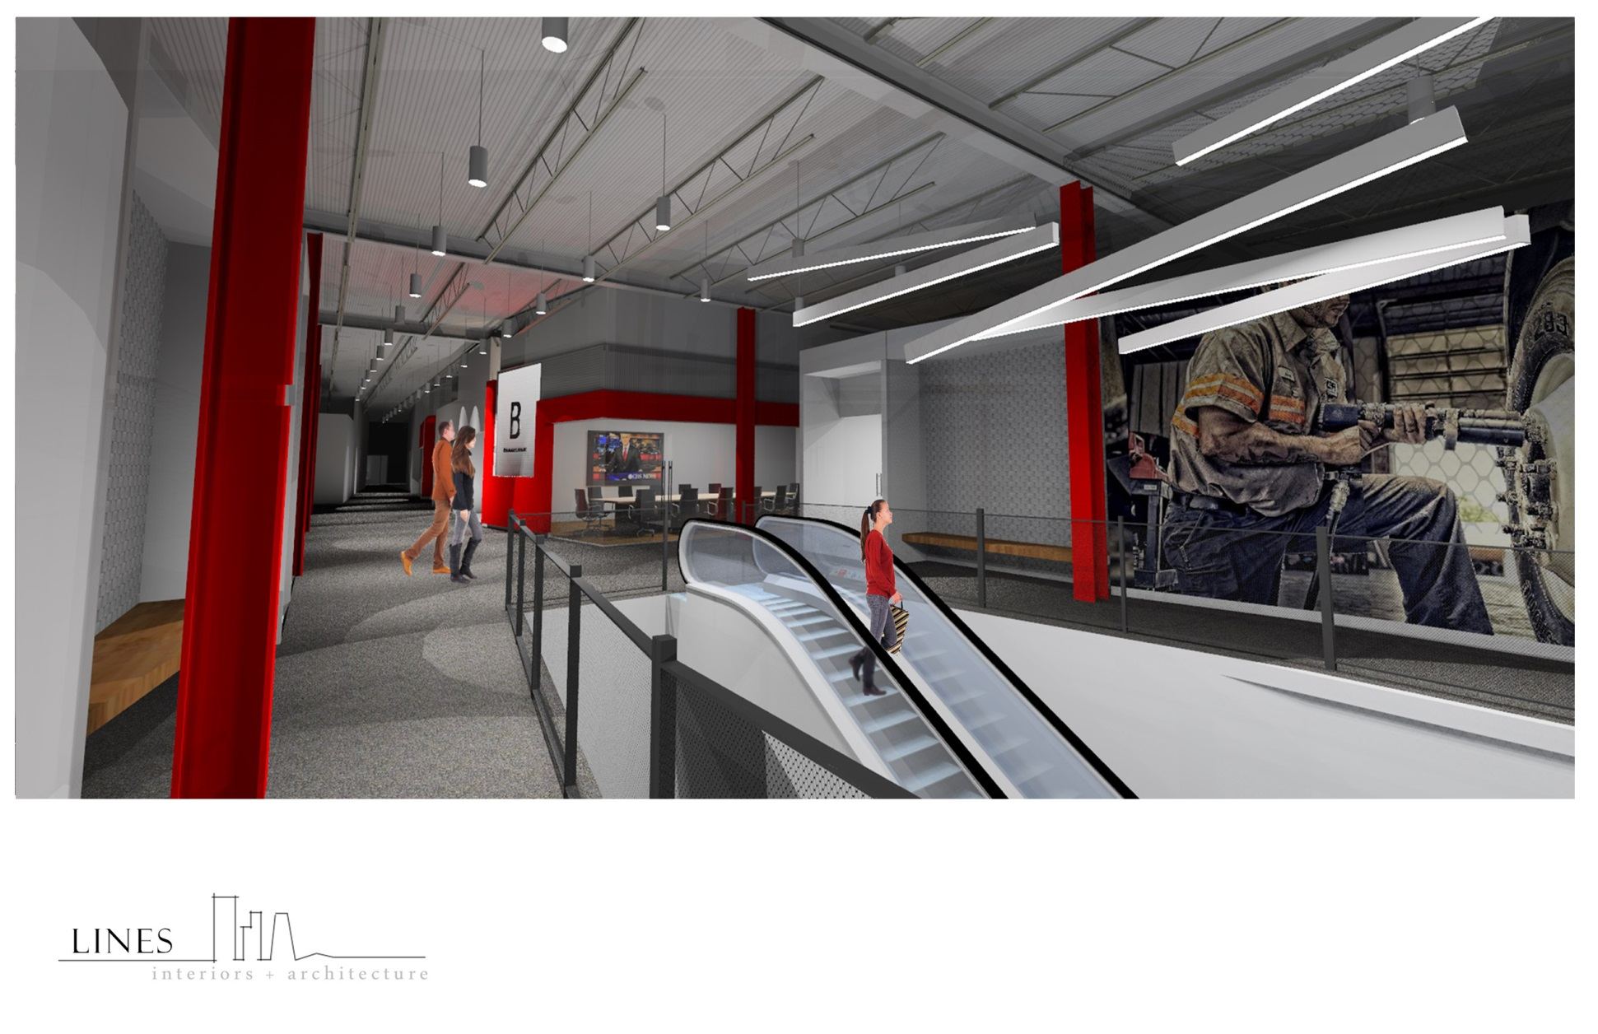
Entry
Prominent branding elements serve to instill brand pride, a key component of the Shaping Tomorrow vision.
Notes:
The design aesthetic reflects the Bridgestone corporate branding creating a contemporary, monochrome design with an industrial twist. The overall industrial style that the design team focused on is emphasized by the use of concrete floors, cold rolled steel, exposed columns and open-to-deck painted ceiling. The monochromatic finish choices strengthen the impact of the company’s logo and branding graphic throughout the space.

Slide 10
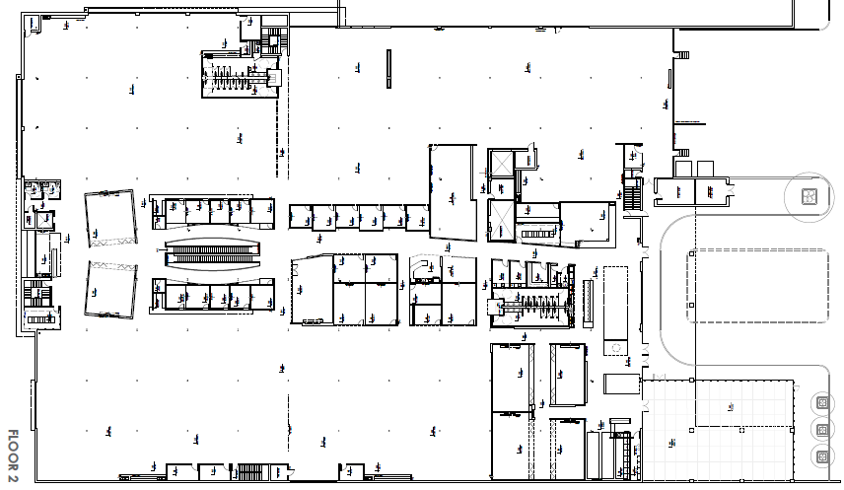
The Floorplan
The building contains considerable conferencing and meeting space, arranged in a “main street” plan to keep traffic out of the work areas.
Shared Services
Customer Service
IT
Conference/Meeting
Dining/Break/Coffee Areas
Bathrooms
Shared Services
Outdoor/ Patio Area
Notes:
Highlight increased conference rooms in centralized locations
Larger training rooms
Patio
Transition into higher ceilings

Slide 11
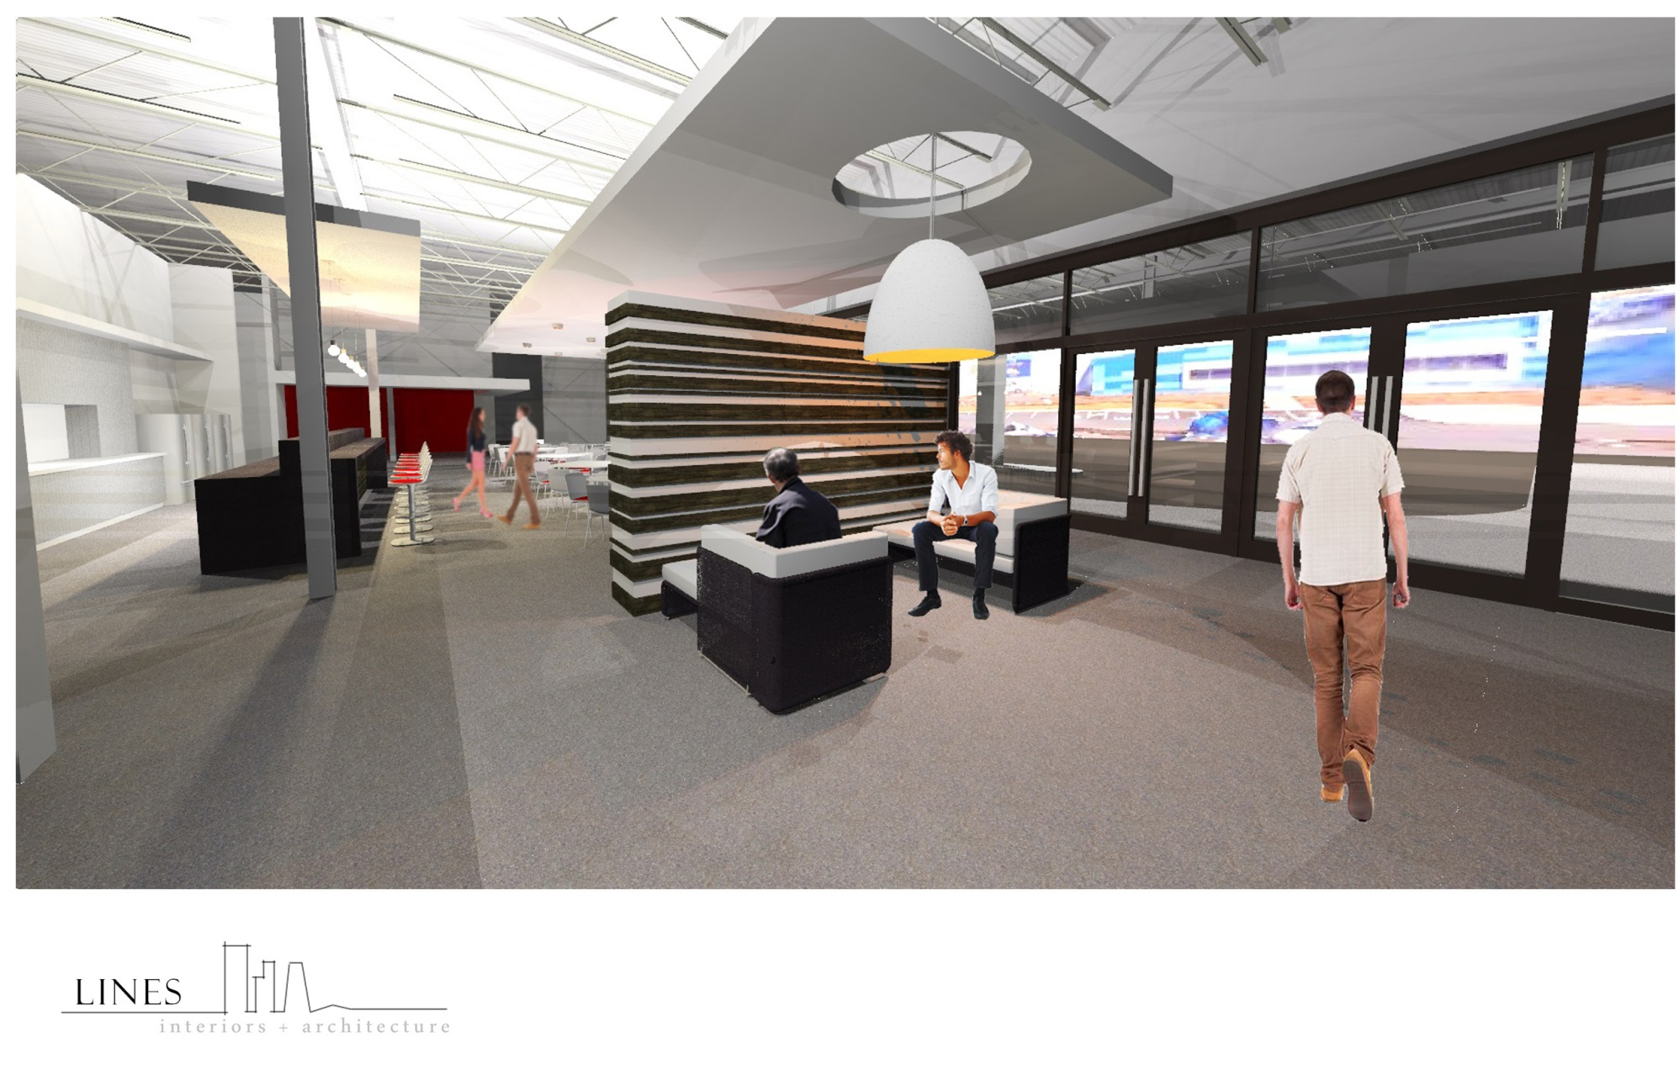
Seating Areas
Multifunctional seating areas provide various settings for quick conversations, informal interactions, and breaks.
Notes:
The goal was to create a feeling of connection between adjacent spaces and departments, a desirable space for employees from separate groups to stop and engage each other when they cross paths, encouraging an atmosphere of sharing, collaboration and cross-pollination of ideas.

Slide 12
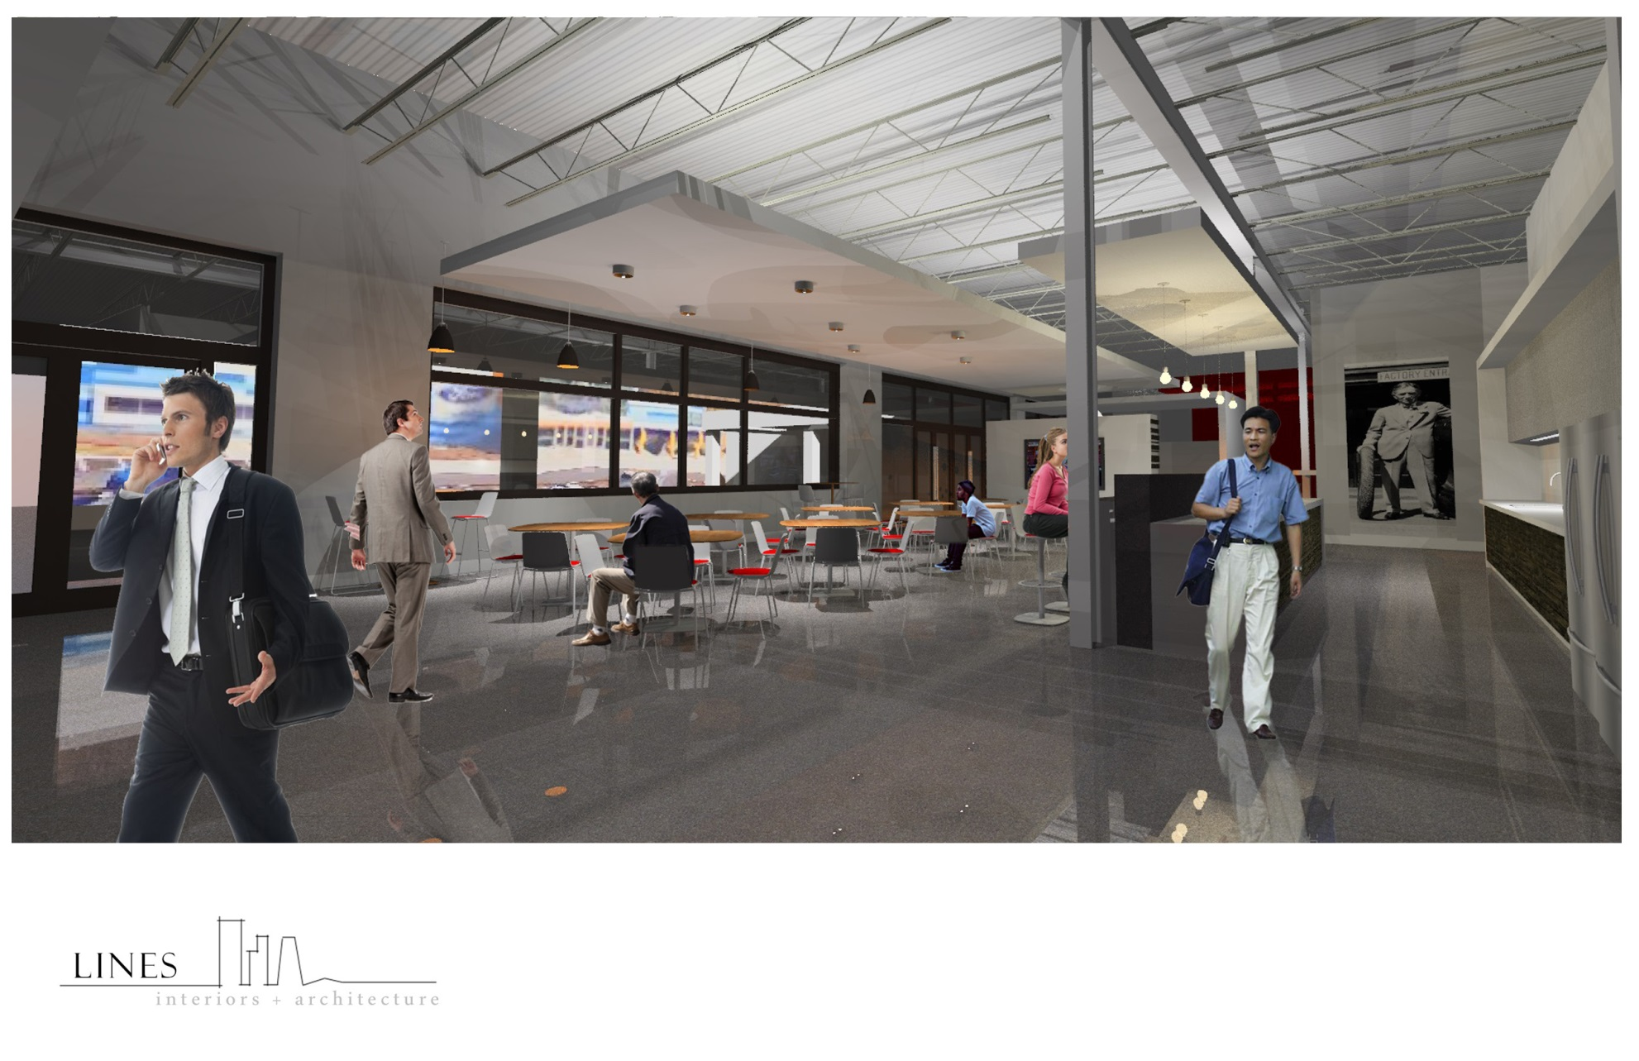
Seating Areas
Common seating adjacent to the entry way is a place to connect and eat lunch.

Slide 13
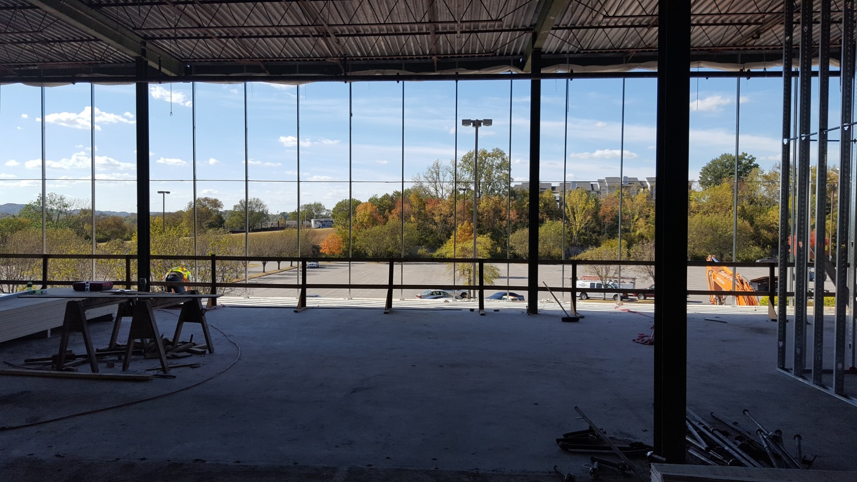
Ceilings and Views
This in-progress construction photo shows the tall ceilings and big windows in the SOC, which present a unique wellbeing benefit.

Slide 14
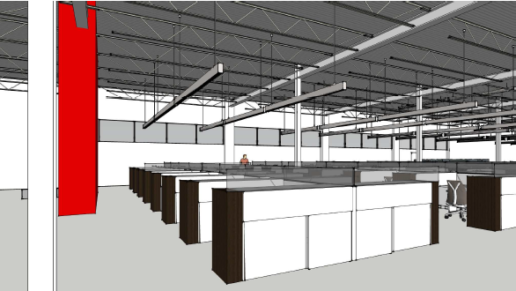
Workspace
The main workspace is adjacent to the window line, with a variety of private meeting spaces arranged nearby, towards the interior of the building.

Slide 15
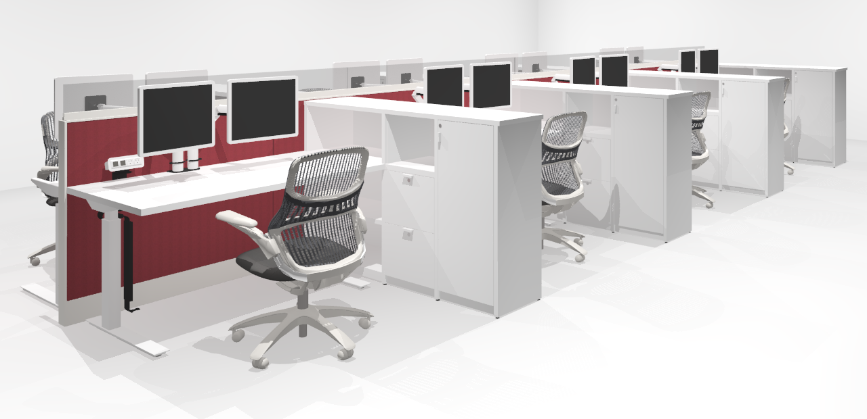
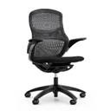
Workstations
Sit / Stand workstations allow teammates to shift postures throughout the day.
70”W x 29”D Electric Height Adjustable C-Leg Table with Laminate Top.
42”H x 24”W Panel with Base Raceway Power, Monolithic, Tackable, Fabric Panel.
7”H x 72”W x 1.5”D Clear Frameless Glass
42”H x 66”W x 15”D Metal Storage Unit with Laminate Common Top. Consists of 30”W Bookshelf with Adjustable Shelf, 18”W Box/Box/File with Laminate Shelf Above, and 18”W Locking Hinged Door with Coat Rod
Desktop Power Module with 2 USB Outlets and 2 Receptacles
42”H x 48”W Panel with Base Raceway Power, Monolithic, Tackable, Fabric Panel
Notes:
Ensure it’s clear we are equipping each desk with the ABILITY to have dual monitors, but are not providing the monitors themselves
Task chairs are on site for the reveal

Slide 16
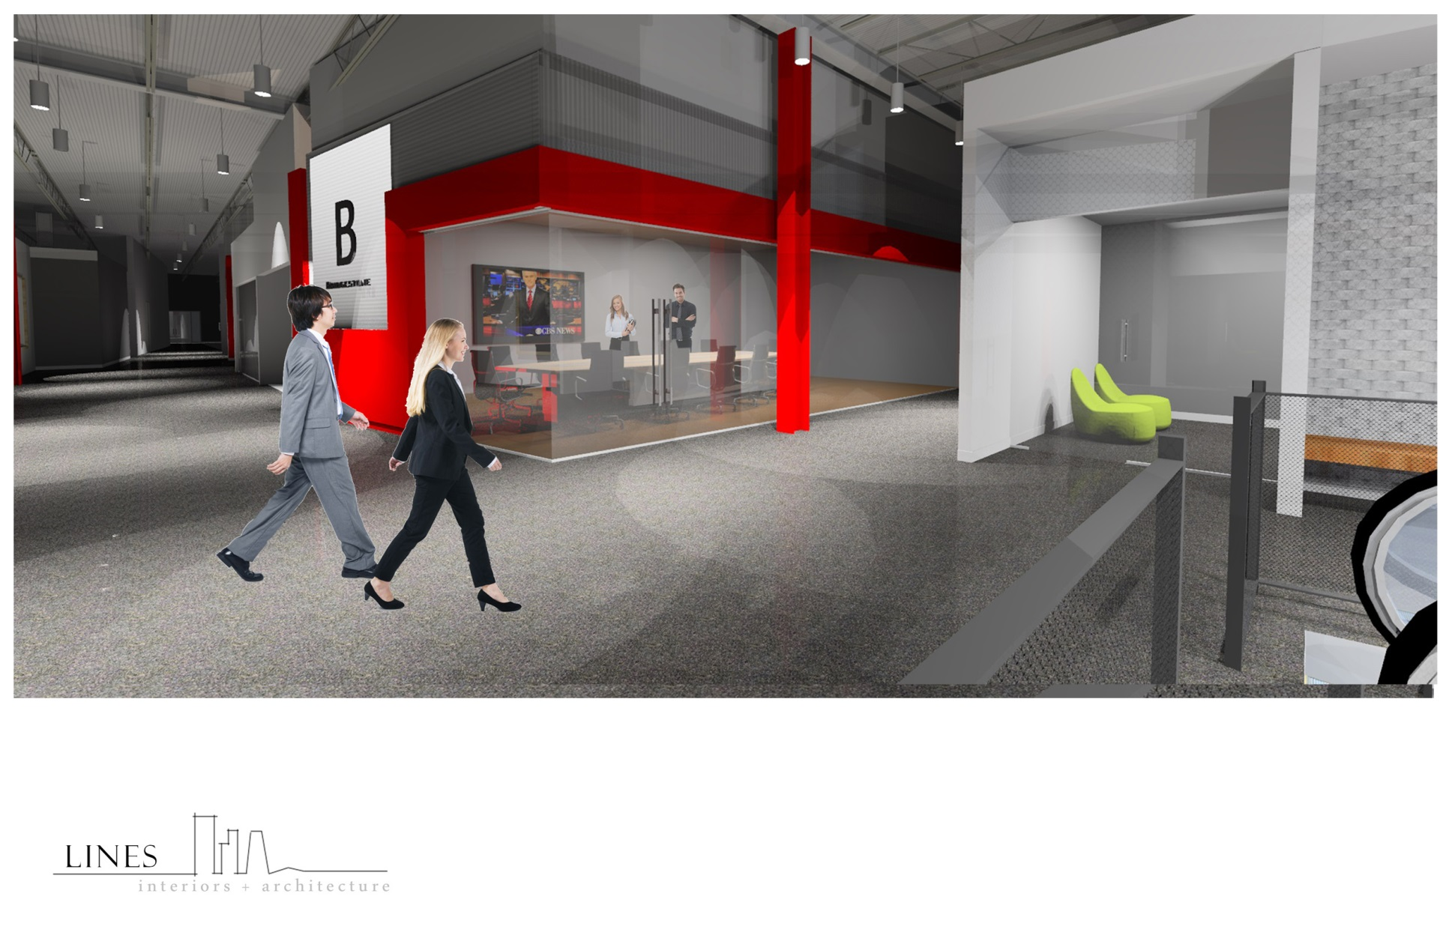
Conference Rooms
The “Main Street” conference room formation contains a wide variety of sizes and settings of meeting rooms adjacent to the open workspace.
Notes:
Conference rooms and enclave spaces strategically located in the center spine enable a collaborative environment to meet, create and evolve. Ideally placed phone booths ensure that employees still have a private spot, amongst the open office layout. A great feature in the design is the meeting rooms with folding glass partitions, “Nanawalls”. This is an ideal space for medium – large group meetings or large company gatherings.

Slide 17
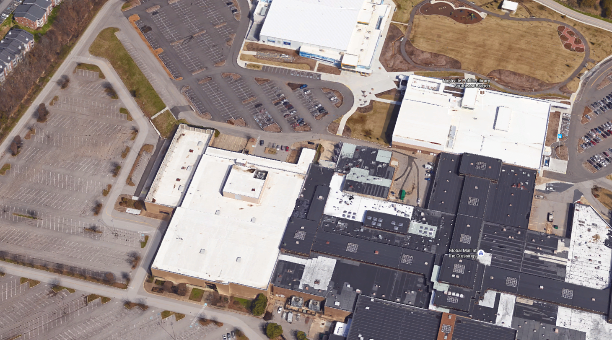
Extended Site Amenities
Just outside of our building are a host of wonderful amenities available for your use.
Ford Ice Center
Outdoor Park
Southeast Nashville Community Center
Service Operations Center

Slide 18
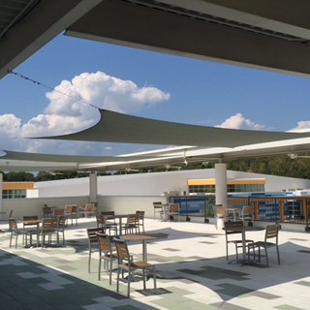
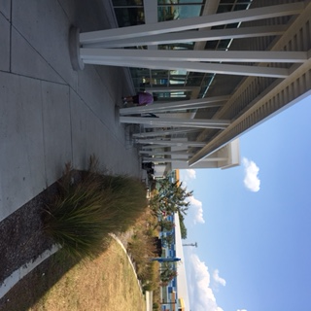
Southeast Community Center
The nearby community center has rooftop outdoor terraces, full fitness facilities including group classes and an indoor walking track, after-school programs for kids, and a branch of the Nashville public library.

Slide 19
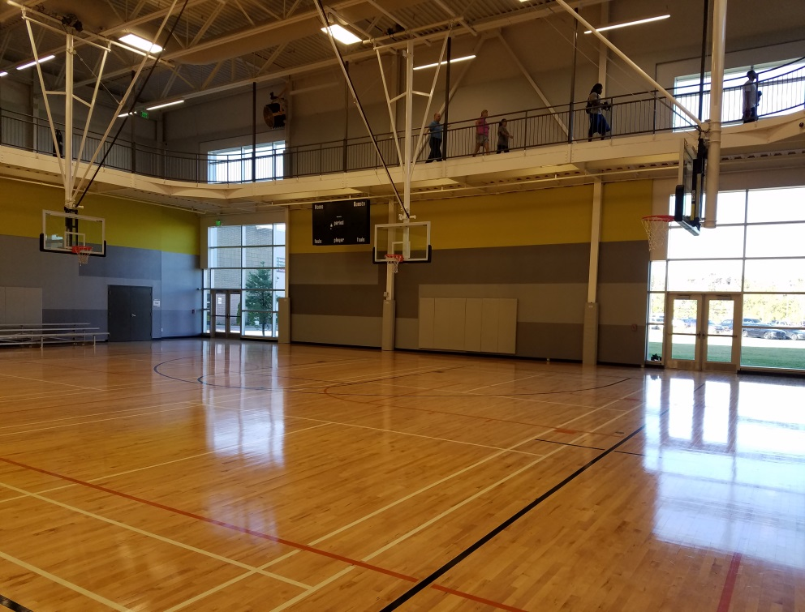
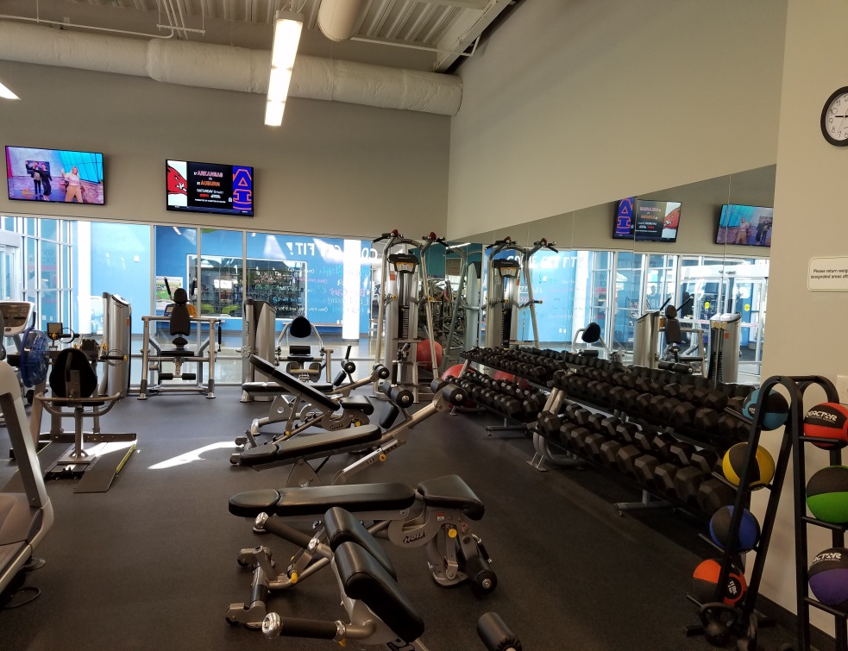
Southeast Community Center
The nearby community center has rooftop outdoor terraces, full fitness facilities including group classes and an indoor walking track, after-school programs for kids, and a branch of the Nashville public library.

Slide 20
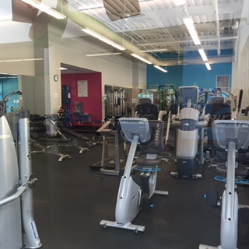
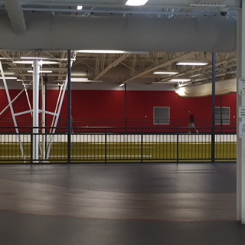
Southeast Community Center
The nearby community center has rooftop outdoor terraces, full fitness facilities including group classes and an indoor walking track, after-school programs for kids, and a branch of the Nashville public library.
D
E

Slide 21
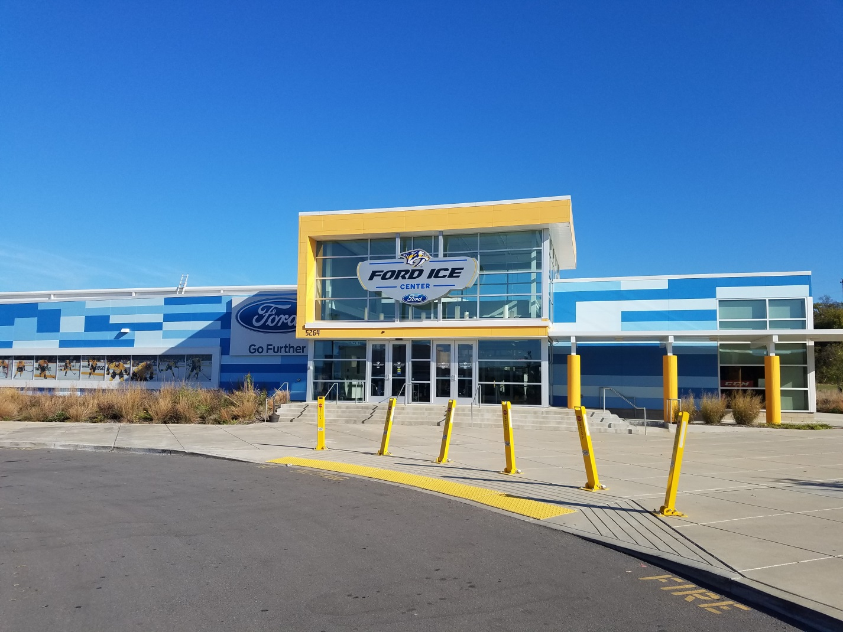
Ford Ice Center
The SOC is located next to the Nashville Predators practice facility, Ford Ice Center.

Slide 22
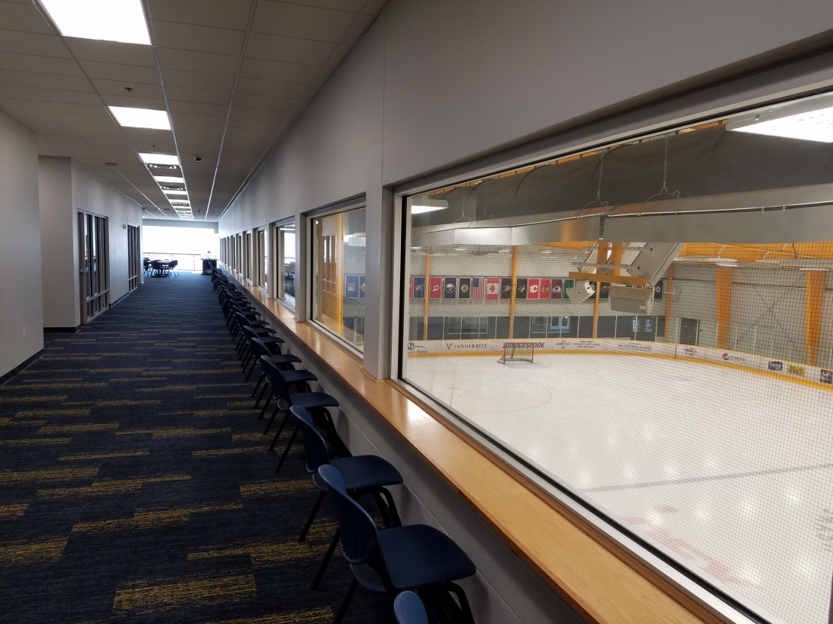
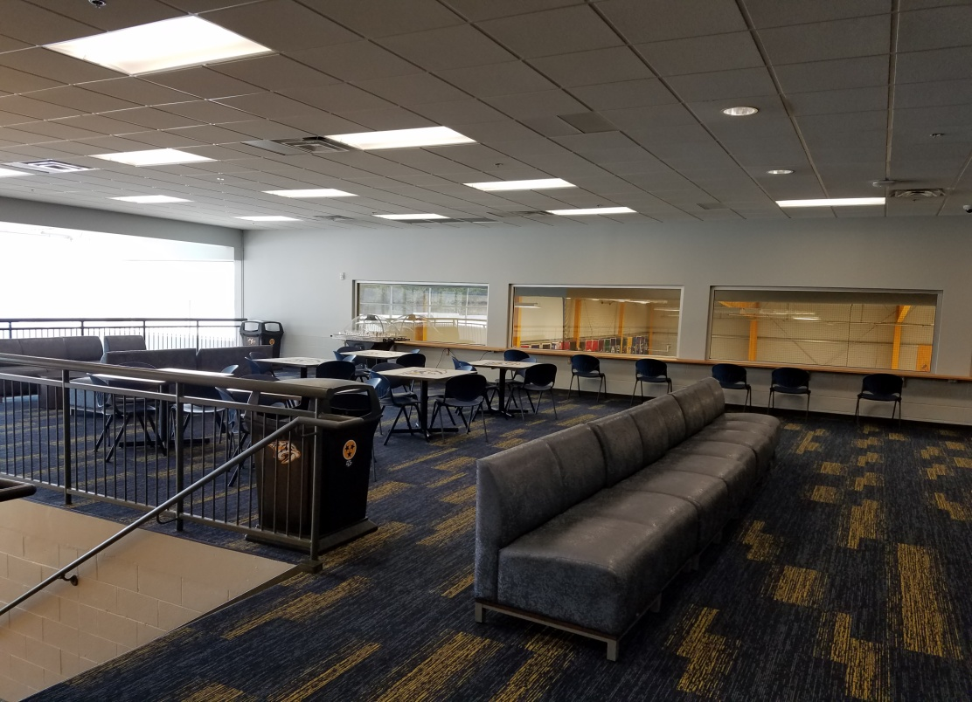
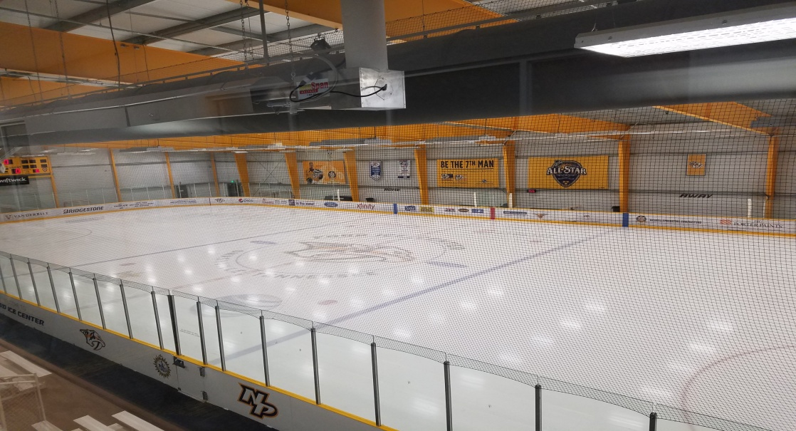
Ford Ice Center

Slide 23
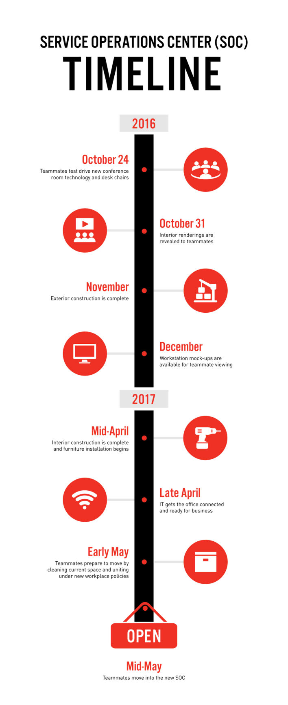
What’s Next
Workstation Mockups (December 2016)
SOC Move-in (Early May 2017)
Project Updates (Quarterly)

Slide 24
Questions?

Slide 25

Activity
What part of the SOC are you most excited about?
Use a sticky note and post your answer on the boards around the room.

